Slide 1

Prediction of Bitcoin Currency
Group 4:
Sushant Burde | Swarnim Jambhule | Kathryn Mak
Pratik Parmar | Monish Phatarpekar | Smit Shiroya
Notes:
Pesentation (4pm, Aug 6th Tuesday)
Presentation Schedule: 4pm - 5:40pm (at Zoom, Aug 6 Tuesday)
20 mins (= 15 mins presentation + 5 min Q&A)
Due to add your presentation slide to your github and email the url address to the instructor (3:45pm, Aug 6).
Group 4: 5:00 - 5:20pm

Slide 2
PPT Guideline from Professor
(Smit review to confirm to add more slides if needed
Team Presentation Rubric: 100%
1. Presentation Slide Format: 30%
a. Font Size (at least 28 font size): 9%
b. Data Size (should be at least 2GB; or need permission to get full credit): 7%
c. Data Source URLs: 6%
d. H/W experimental Specifications (Your server’s OS, memory size, CPU speed): 8%
2. Originality: 20%
How unique your idea (10%)
your deliverable (10%)
Workflow or architecture charts, you may see the example workflow or architecture (2% of 10%)
3. Relevance with the topic in the class: 35%
a. Completeness Visualization in location & time info (Geo-Spatial Visualization) if your dataset has them: 16%
b. Implementation (Flow Chart that shows the architecture of your implementation, for example, https://goo.gl/3AnnPN, https://www.rroij.com/articles-images/IJIRCCE-264-g002.GIF, ): 9%
c. Github link that has all the codes and documents: 10%
4. Communicate with the instructor about the topic to get approval about the topic: 15%
Notes:
http://ceur-ws.org/Vol-2280/paper-06.pdf

Slide 3
Outline
Abstract
Introduction
Background
Related work (other people work similar to urs)
Visualizations
Conclusion
References

Slide 4
Visualization (Just to confirm these 6 visualization for your work Smit).
Bitcoin Market Value 2013-2019
Close Ratio
Max Spread Out Of Bitcoin
Ranking of Cryptocurrency
Volume

Slide 5
Abstract Pls read over, if ok I will have to shrink & condense bcz it’s too wordy for PPT but this is great for the term paper.
A cryptocurrency is a digital money designed to work as a medium of exchange in an electronic payment system in which payments are validated by a decentralized network of system users and cryptographic protocols instead of by a centralized intermediary (such as a bank). Since 2009, cryptocurrencies have gone from being academic concept, niche technological curiosities to rapidly proliferating financial instruments that are the subject of intense public interest. Recently, they have been incorporated into a variety of other financial transactions and products.
For example, cryptocurrencies have been sold to investors to raise funding through initial coin offerings (ICOs), and the terms of certain derivatives are now based on cryptocurrencies. Some government central banks have examined the possibility of issuing cryptocurrencies or other digital currency. Like any investment, these can carry risk. Media coverage of cryptocurrencies has been widespread, and observers have characterized cryptocurrencies as either the future of monetary and payment systems that will displace cash, government-backed currencies, or a fad with little real value.

Slide 6
Background
Pls read over, if ok I will have to shrink & condense… highlight those are must & write on the notes below cuz this paragraph is more generic cuz i wasn’t sure how you want to tie to the project so i have to review what you write in OBJECTIVE or purpose
The world of cryptocurrency and blockchain are constantly evolving and fascinating to many. As one of the most valuable virtual currency that is completely paperless and autonomous, Bitcoin has been the topic of discussion among financial investors, stock traders, software programmers, and the public in general. For centuries in history, people rely on printed money as the major medium of transacting business. Since its first introduction by a Japanese person who uses the pseudonym of Satoshi Nakamoto, Bitcoin and others forms of cryptocurrency open up new spectrum through this form of digital money to provide business transactions that are relatively secure, trusted, reliable. The nature by which cryptocurrency work makes the system less prone to human errors and malicious activities. The system of cryptocurrency as a form of digital money is based upon the idea of blockchain, which can be understood as a ledger that is publicly available and can be monitored simultaneously by hundreds of computer users. The information contained within these blockchains can be verified among the public, thus potentially bypassing a centralized system operated by banks and other financial institutions. The Bitcoin, the Ethereum, and other similar cryptocurrencies presented a relatively volatile fluctuation in its face value. Over time, the market favored a rise in the values of these digital currencies. Although some financial and academic leaders have raised concerns to the reliability of the cryptocurrency system, further research is required to better understand and improve any shortcomings of the cryptocurrency and blockchain system.

Slide 7
Objectives of prediction - Kay (Can you?)
Pls add i’l make reword … what else asside prediction… we did some visualization using kibana to make data more understandable
The aim of this project is to predict one of the cryptocurrency price based on the past data using neural network and using kibana to do visualization to make data more understandable.

Slide 8
Data URL
where is data set from? Why pick some explaination..
https://www.kaggle.com/jessevent/all-crypto-currencies

Slide 9
Methodology
We are going to do some analysis and visualization of trending crypto currency with the help of elasticsearch and kibana and will apply some deep learning method(If Possible) using keras library and build a neural network by doing some python programming to predict the future close price of a particular currency which is bitcoin.

Slide 10
REMINDER slide for us... delete this after
Visualization :
1) Using line graph we are going to display all the price chart on yearly basis.
2) Using pie chart we are going to distribute the volume like which year has the highest volume.
3) Comparison between the opening and the closing price.
Term project should be similar to what you have done at the lab: Collecting Data, Analyze, and Visualize using ElasticSearch (ES) - Optionally Deep Learning (DL) and Prediction using ES or DL - and present the insights you find out.

Slide 11
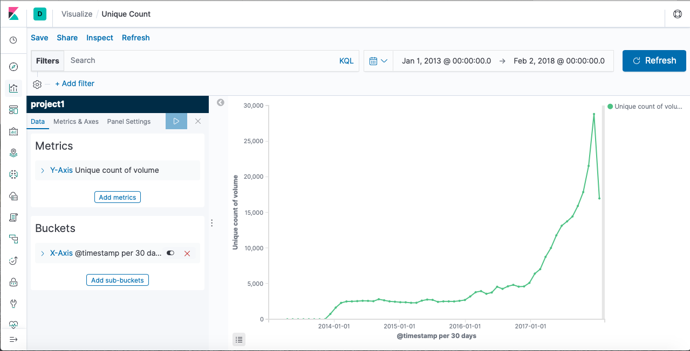
Trend Of Cryptocurrency

Slide 12
Fig. Illustrates the growth rate of count of volume per year. There was a significant increase in the amount of the volume for various cryptocurrency during 2014 to 2017. Later, sudden raise was noticed during 2018, buyers enticed to buy more amount of bitcoin.
As market goes down in late 2018, a sudden fall was recorded which in led more loss to buyers.

Slide 13
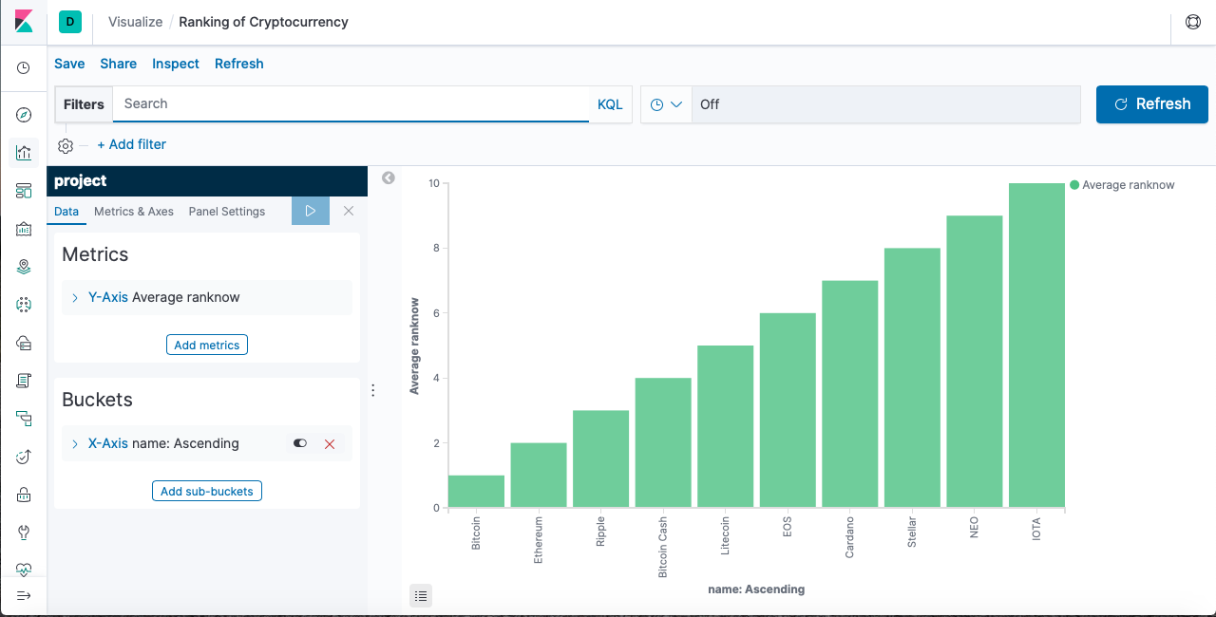
Chart: Currency Based On Rank

Slide 14
Chart illustrates the stock market ranking of various bitcoin available in the market. As per the record, bitcoin lead the market with a significant jump in stock market makes buyers to entice more during the time period.

Slide 15
The average price for bitcoin jumped over 10K dollars which makes difficult other stock to increase their prices. The IOTA and NEO still struggling to achieve the spot in the marketplace. Bitcoin and Ethereum popularity makes them continue to stay at the top spot.

Slide 16
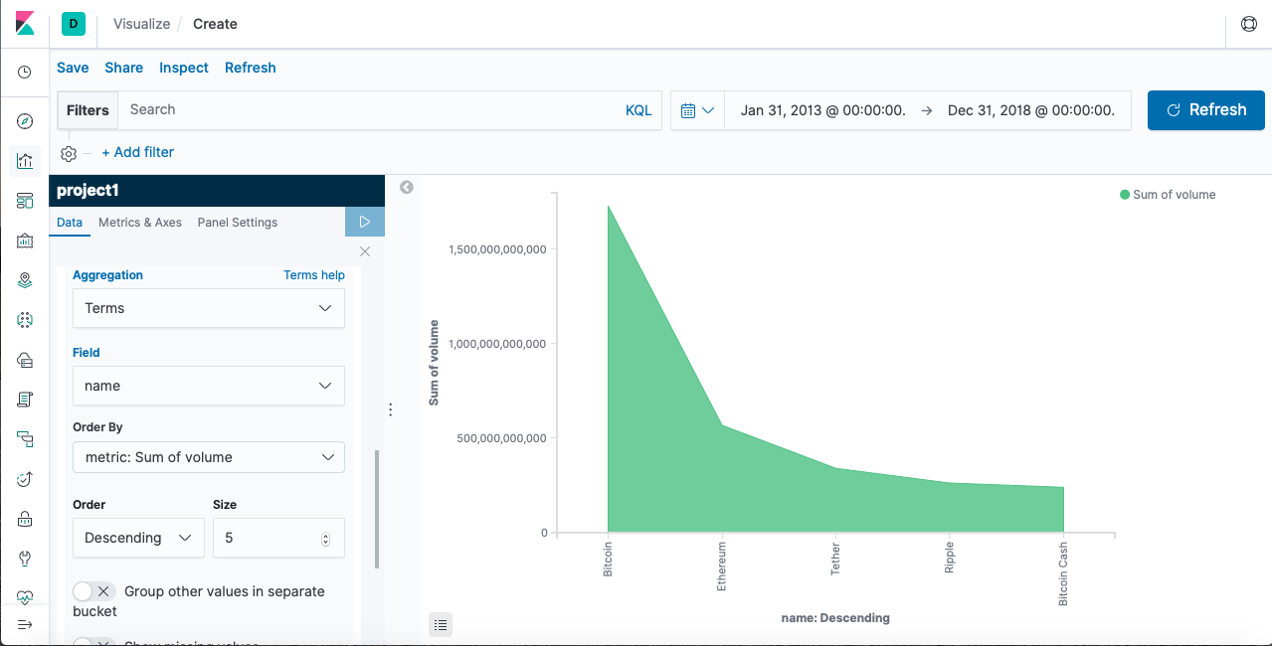
Chart: Currency Based On Volume

Slide 17
Fig shows the overall volume of stock market leading cryptocurrencies. The bitcoin prices rising heavily makes buyer to buy more stock. There were over 1.5B stock recorded for year 2013 to 2018.

Slide 18
Ripple and bitcoin cash struggles to make above average. The volume rate changes according to bitcoin price changes which affects other to increase their prices as well. Probably, the prices for bitcoin was predicted to cross over 13K/ per stock which definitely crash the stock market.

Slide 19
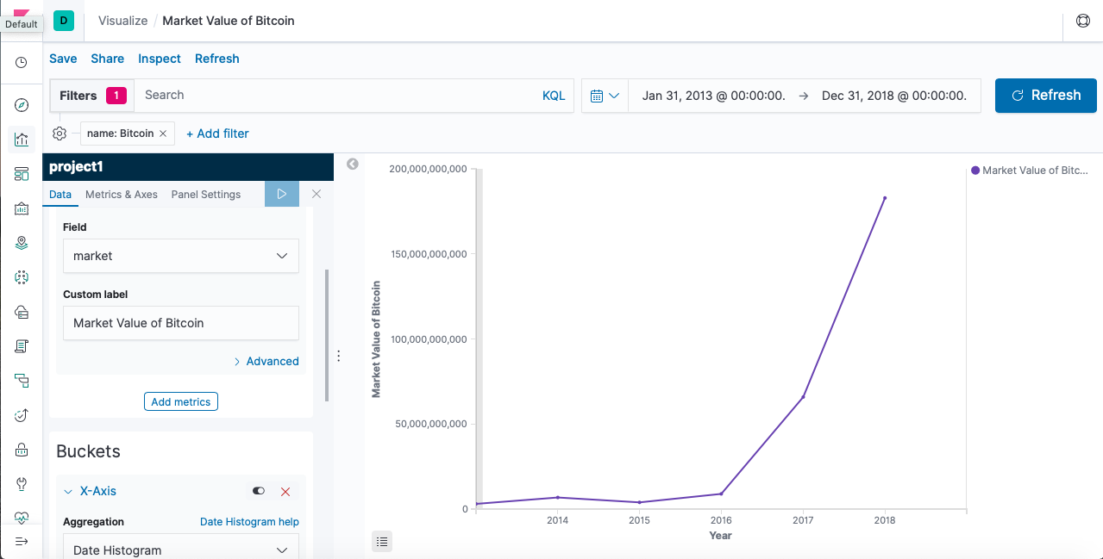
Market Value Of Bitcoin 2013 - 2018

Slide 20
Extra slides for explanation

Slide 21
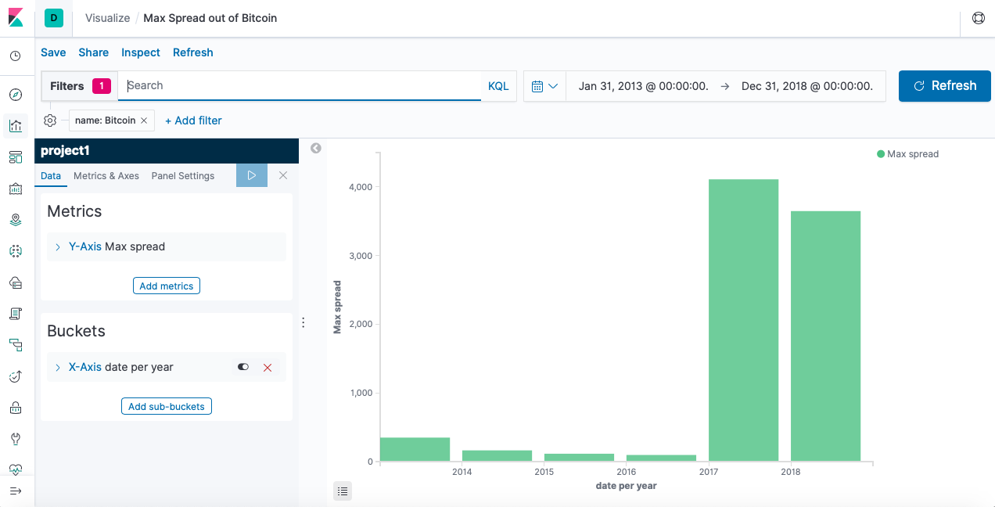
Max Spread out Of Bitcoin 2013 - 2018

Slide 22
Extra slides for explanation

Slide 23
Applying Deep Learning to predict “Bitcoin”
Pls highlight YELLOW those to KEEP & i’ll delete those not highlighted.
Applying Deep learning to predict one particular currency (“Bitcoin”) :
From the dataset we extract the bitcoin data and applied deep learning with the help of python programming.
Libraries : Numpy, Pandas , Sklearn , Keras
Using jupyter platform and with the help python libraries we trained our dataset with 150 epochs and build a neural network using LSTM architecture and adam optimizing algorithm.
In the programming we have also used sigmoid function, The main reason why we use sigmoid function is because it exists between (0 to 1). Therefore, it is especially used for models where we have to predict the probability as an output.Since probability of anything exists only between the range of 0 and 1, sigmoid is the right choice.
When we compare the results with the original one we can see that we have better prediction with LSTM.

Slide 24
Understanding of LSTM
Pls highlight YELLOW those to KEEP & i’ll delete those not highlighted.
Theoretically the naively connected neural network, so called recurrent neural network, can work. But in practice, it suffers from two problems: • vanishing gradient and exploding gradient, which make it unusable.
Then later, LSTM (long short term memory) was invented to solve this issue by explicitly introducing a memory unit, called the cell into the network.
Long short-term memory (LSTM) is an artificial recurrent neural network (RNN) architecture used in the field of deep learning. A common LSTM unit is composed of a cell, an input gate, an output gate and a forget gate. The cell remembers values over arbitrary time intervals and the three gates regulate the flow of information into and out of the cell.LSTM networks are well-suited to classifying, processing and making predictions based on time series data, since there can be lags of unknown duration between important events in a time series. LSTMs were developed to deal with the exploding and vanishing gradient problems that can be encountered when training traditional RNNs.
LSTMs contain information outside the normal flow of the recurrent network in a gated cell. Information can be stored in, written to, or read from a cell, much like data in a computer’s memory.The cell makes decisions about what to store, and when to allow reads, writes and erasures, via gates that open and close.

Slide 25
Those gates act on the signals they receive, and similar to the neural network’s nodes, they block or pass on information based on its strength and import, which they filter with their own sets of weights.
Those weights, like the weights that modulate input and hidden states, are adjusted via the recurrent networks learning process. That is, the cells learn when to allow data to enter, leave or be deleted through the iterative process of making guesses, backpropagating error, and adjusting weights via gradient descent.

Slide 26
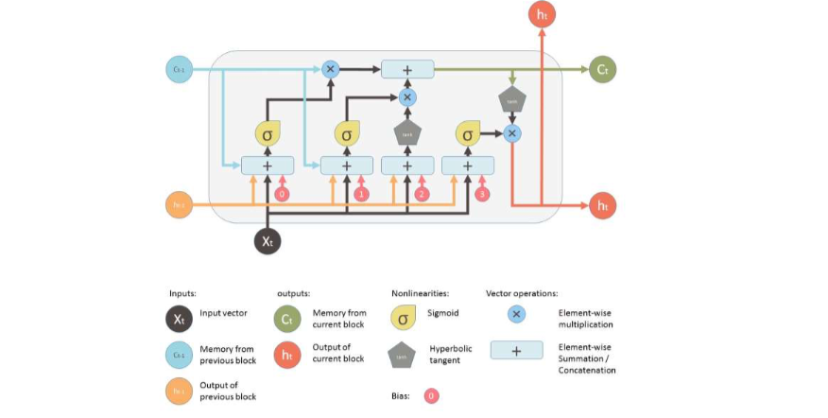
Architecture of LSTM Network:

Slide 27
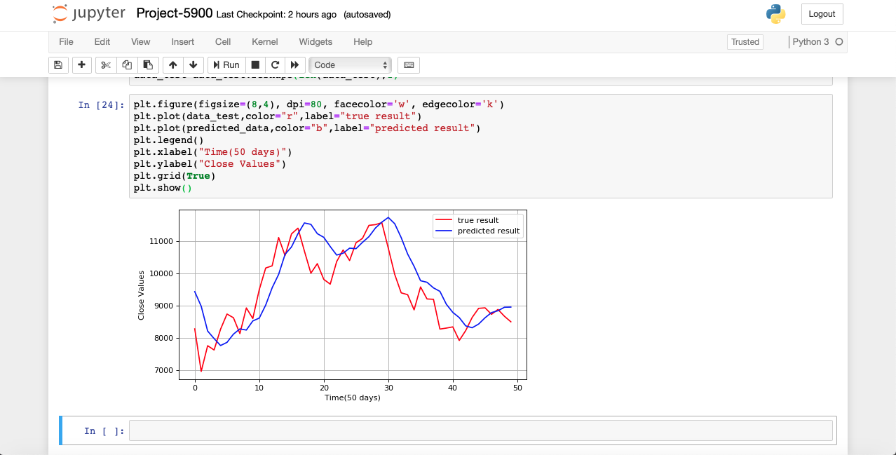
Output

Slide 28
References
A Beginner's Guide to LSTMs and Recurrent Neural Networks. (n.d.). Retrieved from https://skymind.ai/wiki/lstm
Yan, S. (2017, November 15). Understanding LSTM and its diagrams. Retrieved from https://medium.com/mlreview/understanding-lstm-and-its-diagrams-37e2f46f1714
Notes:
Use this website ---> www.citationmachine.net/

